Slide 1
Microsoft Teams API in Microsoft Graph
NarasimaPerumal Chandramohan
Co-Founder, JiJi Technologies Private Limited
Microsoft Office 365 MVP
@narasimaperumal

Slide 2
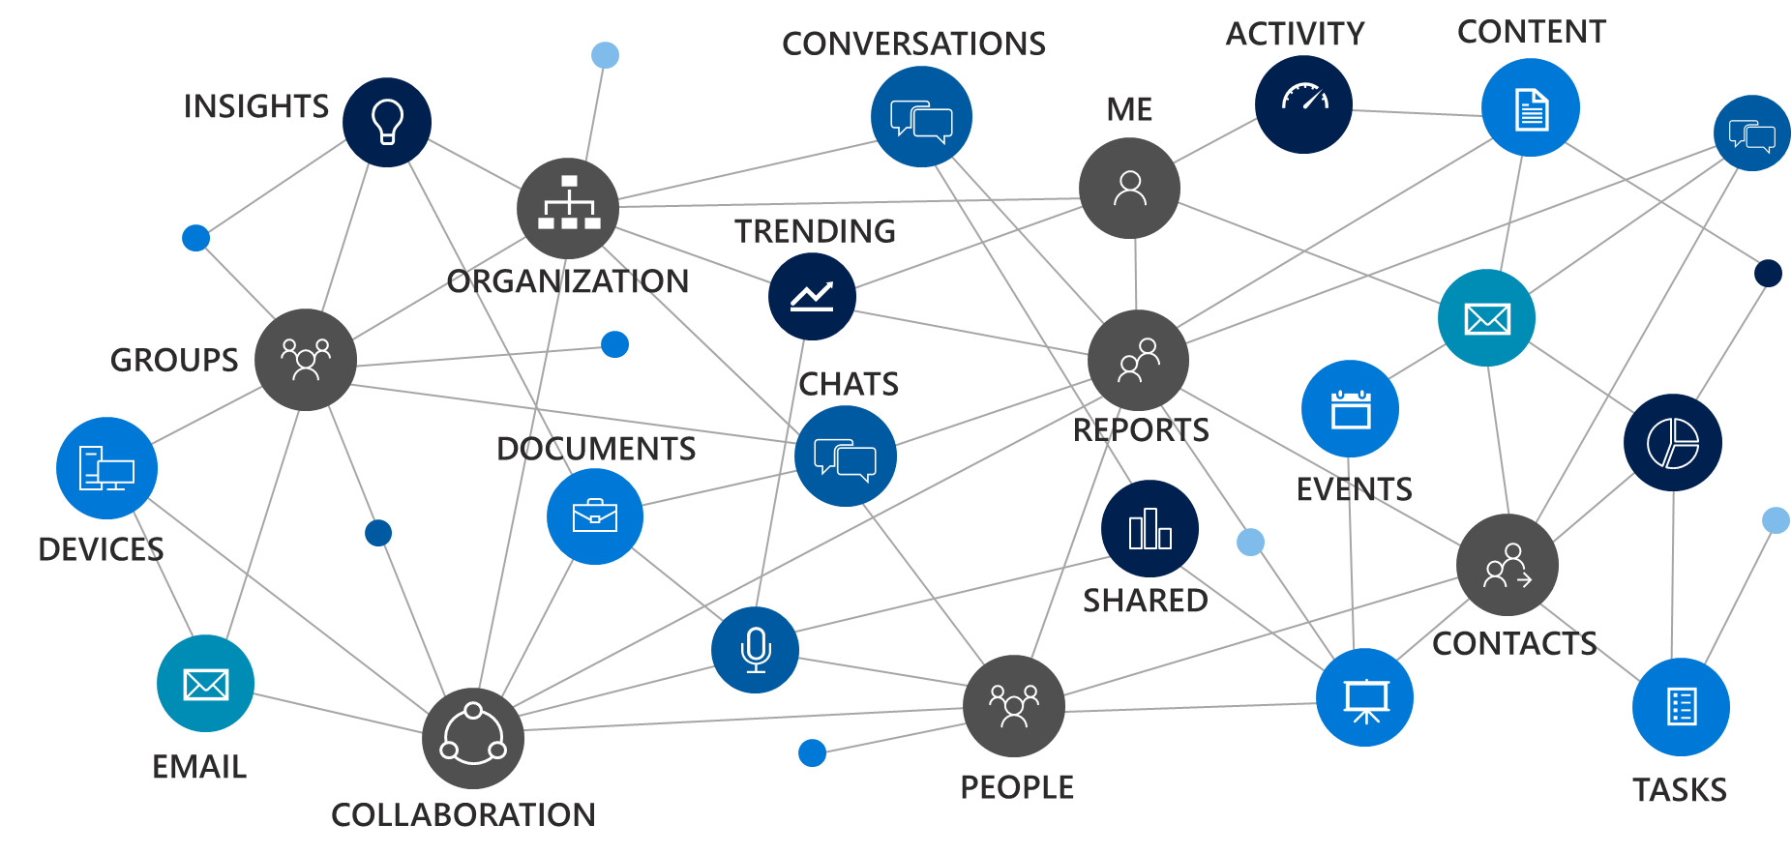
Microsoft Graph
a unified REST API
and comprehensive developer experience
for integrating the data and intelligence
exposed by Microsoft services.
Notes:
Most of you came to this conference because you have real customers that have data in Microsoft Services. Microsoft Graph is the way to access that data.

Slide 3






A powerful platform for higher performing teams
Tabs
Bots
Surface rich content within Teams
Help users get tasks done in conversations
Connectors
Activity Feed
Post rich updates to channels
Engage users via feed notifications
Actionable Messaging
Messaging Extensions
Add rich interaction to your connector cards
Allow users to query and share rich cards in conversations
Microsoft Graph
Build in intelligence and connect to data that drives productivity

Slide 4


A powerful platform for higher performing teams
Tabs
Bots
Surface rich content within Teams
Help users get tasks done in conversations
Connectors
Activity Feed
Post rich updates to channels
Engage users via feed notifications
Actionable Messaging
Messaging Extensions
Add rich interaction to your connector cards
Allow users to query and share rich cards in conversations
Web sites
Services

Slide 5
Graph can automate team lifecycles
Create a team
Add members and owners
Configure team settings
Add channels
Archive or delete the team when the time comes
Install apps
Add tabs

Slide 6
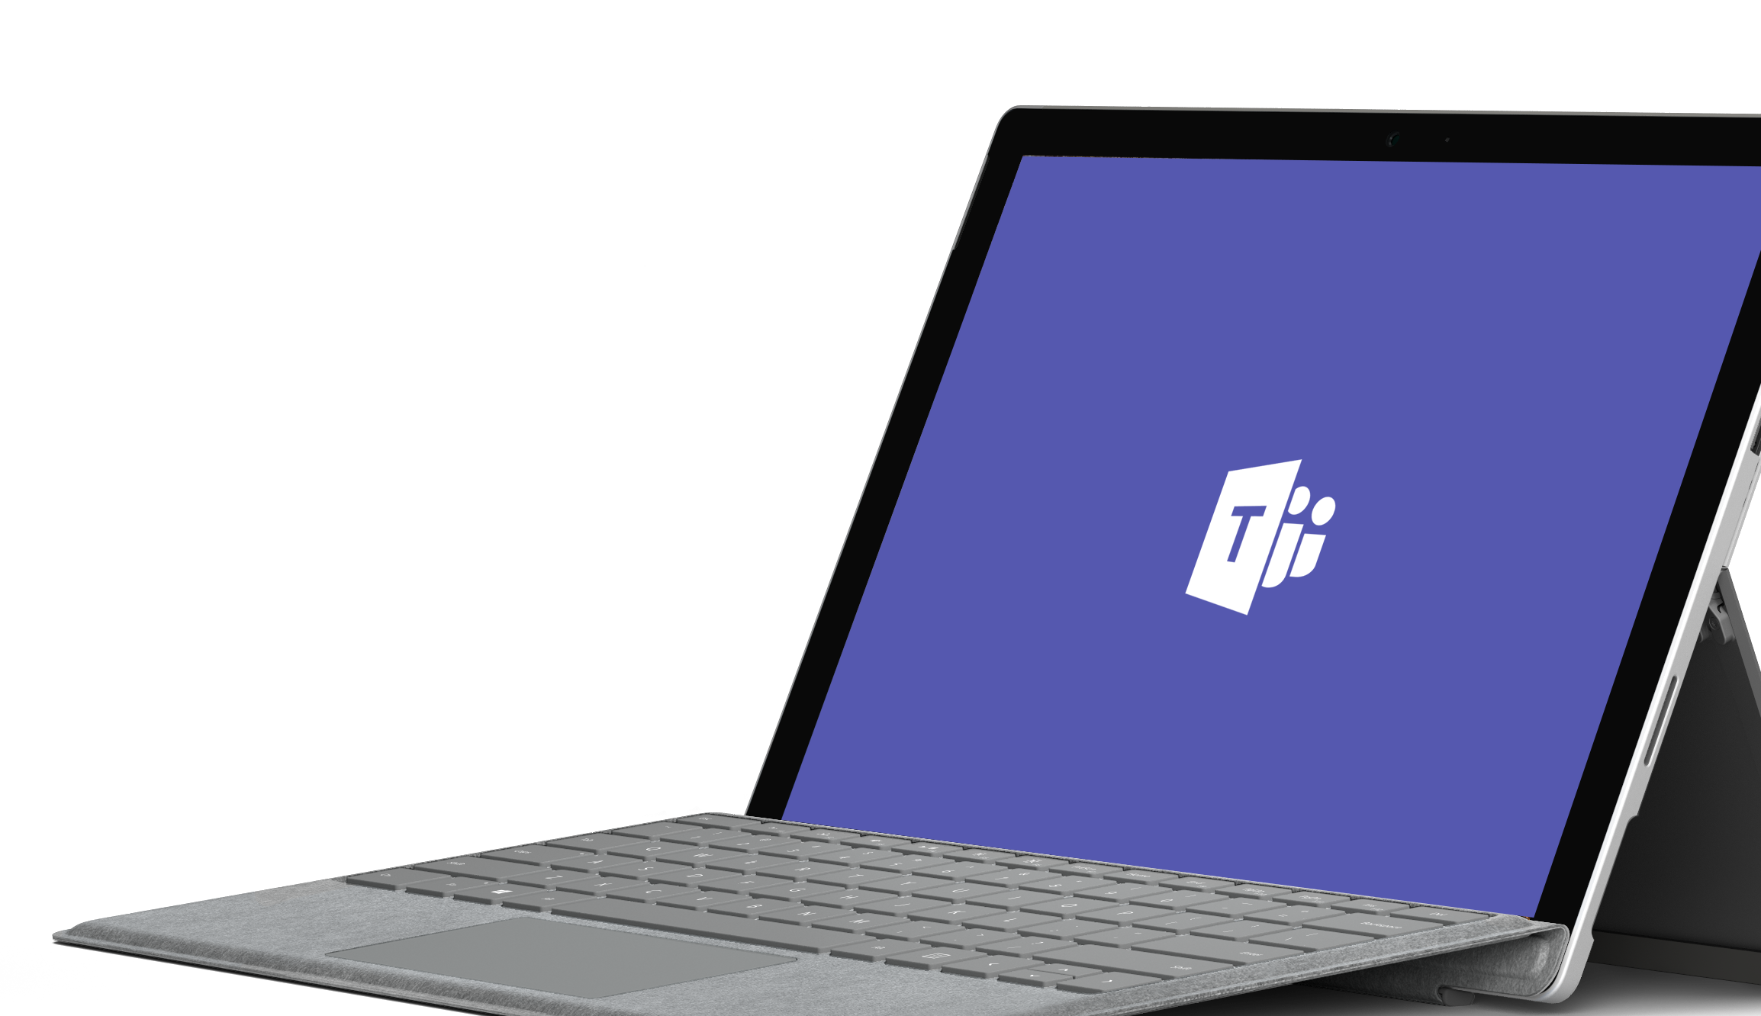
Demo
Notes:
Demos are most effective with customers enabling us to bring the product to life. Please leverage the demo script on Office OnRamp: https://view.officeapps.live.com/op/view.aspx?src=https://demos.microsoft.com/api/download/00000000-0000-0000-0000-000000000000/636551932331784273/Microsoft%20Teams%20Demo%20Guide.docx
As alternative to a live demo, please leverage the PowerPoint Click Through Demo or the following six slides.
If you demo Teams, you can use the slides to recap the main points of the demo.

Slide 7
App registration
Graph calls need a Graph appId.
Graph appId != Teams appId
Register a Graph app:
https://apps.dev.microsoft.com
Create a Converged Application
Or use your botId if you have a bot.

Slide 8
Permissions
Two types of permissions:
User delegated permissions for when there is a user present
Application permissions for when there isn't
Teams APIs require Group.Read.All or Group.ReadWrite.All
For user delegated, means all groups the user can read/write
For application permissions, means all groups in the tenant
Admin consent required for both user delegated and application permissions

Slide 9
APIs available today in v1.0
Resource | Actions | App permissions?
Team | List, create, read, update, delete Clone Archive/unarchive | Supported
Members & Owners | List, add, remove | Supported
Team Settings | Read, write | Supported
Channels | List, create, read, update, delete | Supported
Tabs | List, create, read, update, delete | Supported
Apps installed in teams | List, install, upgrade, remove | Supported
App catalog | List, publish, upgrade, remove | No, user-delegated only

Slide 10
Hot off the press
Admin permissions
Configuring Word/Excel/PowerPoint/PDF tabs
Bulk add members
Create team + channels + settings + tabs in one call
Channel deep link
Channel e-mail address
Available in v1.0 & beta
Available in beta

Slide 11
Get started today: https://graph.microsoft.com
Docs: https://aka.ms/teamsgraph/v1
Samples: https://github.com/microsoftgraph/contoso-airlines-teams-sample
Feedback:
UserVoice
Stack Overflow ([microsoft-graph] [microsoft-teams])
mailto:TeamsGraph@microsoft.com

Slide 12
Next steps
Resources
Get started Start using Microsoft Teams today
Get technical with Microsoft Teams Development Education series
Play with hands-on-labs
Join the Teamwork Solution Accelerator for Partners
Access resources & support Get Teams deployment & adoption support from
FastTrack
https://aka.ms/SuccessWithTeams
Teamwork Solution Accelerator: https://aka.ms/TeamworkSolutionAccelerator
Teamwork Assessment Workshop: aka.ms/TeamworkAssessment
Teams Dev center: https://aka.ms/TeamsDeveloper
Developer support: https://aka.ms/TeamsDevSupport
Teams Dev docs: https://aka.ms/TeamsDevDocs
Notes:
When you follow up with the customer, here are additional resources to point them to:
Practical Guide to the Modern workplace: https://resources.office.com/ww-landing-M365E-Practical-Guide-to-the-Modern-Workplace-WhitePaper.html?LCID=EN-US

Slide 13

Enjoy the Bootcamp

Slide 14

Call to action
(Recommendation to Bootcamp organizers and speakers: This slide can be used at the end of the Bootcamp to have attendees to fill online feedback form and recommendation for their ongoing learning and app development on Office 365 platform. Please keep the first three bullet points, you can update the last bullet point to be the user group or community that you are leading that you’d like attendees to join and learn more. Please keep the first feedback bullet point at the top and feel free to re-arrange the rest of bullet point orders. Thanks.
Share your feedback on Bootcamp at https://aka.ms/o365devbootcampfeedback
Join Office 365 developer program https://dev.office.com/devprogram to leverage all resources for Office 365 development learning
Build applications on Office 365 platform
Attend MVP led local community events to continue learning on Office 365 development

